Slide 1

HMPPS – Probation
Personal Protective Equipment [PPE]
Updated 02/04/20
Version 0.2
Update: Updated based on feedback from jim, Cris and Amy.

Slide 2
Introduction
The following document sets out the current guidance on the use of PPE and hygiene provision within the probation system. It provides details of when PPE is required, what PPE should be used and where PPE can be obtained in line with Public Health England [PHE] and HMPPS guidelines. This guide will also provide practical advice on managing the risks posed to our key workers delivering probation services.
Key Definitions:
Social Distancing: The act of creating a distance between you and all other members of the public. Government guidelines are for individuals to stay at home save for essential travel and one act of exercise each day. In a probation setting this refers to the act of maintaining a distance of 2m from other individuals whilst in the work place.
Social Isolation: Isolating oneself from other people as a result of being symptomatic or living with someone who is symptomatic. Individuals with certain underlying health conditions may also choose to self-isolate.
PPE: [Personal Protective Equipment] in the context of this document PPE refers to the equipment one might need when working in proximity to an individual with the symptoms of COVID-19 or with a diagnosis of COVID-19. Current PHE guidelines state that PPE is only required in those instances.
Hygiene Provision: This refer to items that support a safe working environment and are essential supplies in our offender contact centres and Approved Premises [APs] but are not considered PPE. They include, hand sanitiser gel, soap, cleaning materials.
Symptomatic and Confirmed Cases: A symptomatic individual is one that is displaying any of the perceived symptoms of the COVID-19 virus as per PHE guidance. Those symptoms are: new and persistent cough, fever, loss of taste/smell. A confirmed case is one where an individual has tested positive for COVID-19. Where medical advice indicates a confirmed case has recovered from the virus, those individuals should no longer be treated as symptomatic or confirmed.
IP&C: Infection, Prevention and Control

Slide 3
Summary of Key Points
The use of PPE is only essentially required for those staff in close contact with someone that is symptomatic of COViD-19
Social distancing should be maintained at all probation sites. In those exceptional circumstances where social distancing can’t be maintained PPE should be worn even if the individual is not symptomatic. There is no PHE or HMPPS requirement to wear PPE in such a situation.
Social distancing and good personal hygiene, specifically hand washing, is the primary measure for protecting yourself against the virus and preventing its spread.
Particular steps on personal hygiene during face to face contact with offenders are detailed within.
Specific guidance for the use of PPE and personal hygiene in APs is also included in Appendix B of this document.
This guidance is specific to circumstances relating to COVID-19. Where there is an existing business as usual process that requires the use of PPE, that process should continue to be followed.

Slide 4
Type and Use of PPE
The following PPE has been identified in line with PHE’s Guidance and is a specific response to COVID-19. The minimum level of PPE for custodial and approved premises staff required when dealing with a suspected COVID-19 case is set out below. Please note, all offenders with symptoms of COVID-19 should be self-isolating until 7 days clear of symptoms and should not be attending offender contact sites where contact over the phone is available as an alternative.
Residents in APs should self isolate in their room and the AP guidance in annex B should be followed. See appendix B for specific guidance on APs.
Where contact is necessary, activities with close contact [less than 2m in distance] with a symptomatic person staff should wear:
Disposable gloves
Fluid repellent surgical face mask
A disposable plastic apron and disposable eye protection (e.g. face visor or goggles)
Individual use alcohol hand sanitisers.
PHE state that PPE must be changed on a regular basis (every 2-4 hours - 4 hours as a minimum) and that it should be removed in an order that minimises the potential for cross-contamination [see next slide]

Slide 5
Removal of PPE
Before leaving the room where the symptomatic or confirmed case is held, gloves, gown and eye protection should be removed (in that order) and disposed of as clinical waste. After leaving the area, the face-mask can be removed and disposed of as clinical waste in a suitable receptacle.
The order of removal of PPE should be as follows:
Peel off gloves and dispose in clinical waste;
Perform hand hygiene, by hand washing or using alcohol gel;
Remove apron by folding in on itself and place in clinical waste bin;
Remove goggles/visor only by the headband or sides and dispose in clinical waste;
Remove fluid repellent surgical face mask from behind and dispose in clinical waste;
Perform hand hygiene.
All used PPE must be disposed of as Clinical Waste. Scrupulous hand hygiene is essential to reduce cross contamination. Coronaviruses can be killed by alcohol hand gel and most disinfectants. Handwashing with soap and water is still the best way of cleaning ones hands and protecting against COVID19.

Slide 6
Allocating PPE
In APs a starter pack of PPE should be ordered for each of our AP sites to ensure access to PPE is available if a resident starts to display COVID-19 symptoms. Stocks of PPE do not need to be stored in OCCs.
Where there is a requirement for additional PPE, provision should be ordered from the PPE hubs.
All suspected cases of COVID-19 must be reported to both to public health authorities: https://www.gov.uk/health-protection-team and to COVID-19 central reporting team.
To obtain PPE the site must contact their local regional PPE hub SPOC and provide the following information:
Sites will arrange their own transport to the Regional PPE Hub for the collection of the PPE and Hygiene products.
For instances where there is an individual with symptoms or a confirmed case, the Regional PPE Hub will meet and provide the incident site’s identified transport with the agreed PPE and Hygiene products.
In the event further stock is required by the incident site, contact should be made directly to the Regional SPOC. If a Regional Stock has levels of provision unable to sustain further periods then Incident Control will make contact with neighbouring Regional SPOCs for support.
1. | Has a medical assessment been undertaken | Yes No
2. | What were the symptoms displayed | Fever or Cough or Other
3. | If a resident of an AP are they sharing a room | Yes No
4. | How many staff will be required to wear PPE
6. | Is this an initial 72 hour supply or a request beyond PPE supply | Initial 72 hour supply Request beyond PPE supply

Slide 7
Hygiene
All HMPPS business areas must enforce infection control precautions particularly in a closed-residential environment where viruses can spread easily. This includes good basic hand and respiratory hygiene for everyone as well as keeping potentially infectious staff temporarily away from the work environment. Enhanced hygiene practices must be included in site cleaning regimes, focusing on frequently touched surfaces such as handrails, taps and door handles. Following the “Catch it, Bin it, Kill it” advice when sneezing or blowing your nose will reduce the risk of spreading infection.
Hand hygiene
Good hand hygiene includes the routine use and access to water and liquid soap, these should be wall mounted above hand wash sinks where possible. HMPPS workers hands and those of prisoners and residents in approved premises are likely to be superficially soiled (handling keys, contact with the environment e.g. door handles, handrails etc.) and washing these off reduces the chance of contamination.
The minimum standards for sites should reflect general public expectations of cartridge filled, wall mounted liquid soap above hand wash sinks in communal areas where possible.
Staff should be regularly reminded to use their nearest hand washing sink to reduce risk of cross contamination. Sites should ensure prisoners and residents have access to soap and water within their accommodation areas and they are regularly encouraged to wash their hands.
As a further control wall mounted hand sanitiser should be installed within site entrances, prison receptions and visits areas. These should contain alcohol-based hand sanitiser products. Sites are mandated to carry out a risk assessment identifying the strict controls of these items and their appropriate location to prevent misuse. The assessment must also consider potential fire risk of these products.

Slide 8
Maintaining Hygiene Standards for face to face contact with offenders
Offender Contact Centres:
It is important that HMPPS employees maintain a safe distance from offenders when supervising them face to face and that good hand hygiene is maintained for both offender and employee before and after face to face contact. The following steps should be followed
Enquires about an offender’s health should be made before inviting them to an offender contact site. Face to face contact should be avoided if they describe themselves as having any of the recognised COVID-19 symptoms. Offenders should be seen in offender contact centres on a rota to minimise the number of offenders visiting a site at any one time
Offenders should be instructed to keep a distance of 2m from others whilst in the waiting area. If facilities at a reporting centre do not permit a distance of 2m to be maintained then face to face reporting should not take place.
Offenders that display any of the recognised symptoms of COVID-19 should not be seen face to face. Other methods of remote supervision should be used instead
Upon arrival offenders should be directed to wash their hands.
No physical contact [e.g., handshaking] with offenders
Transporting an offender to an interview room should only be done when both the offender and the offender manager have washed their hands
Where possible, interview offenders in rooms with adequate ventilation and maintain the 2m distance
Wipe down surfaces in interview rooms after each supervision session
Direct offenders to wash their hands upon leaving the site
Offender Managers should wash their hands after each offender supervision
Offenders who are symptomatic or have been diagnosed as having COVID-19 should not be supervised face to face.

Slide 9
Maintaining Hygiene Standards for face to face contact with offenders
Door Step Visits:
It is important that HMPPS employees maintain a safe distance from offenders when supervising them face to face during doorstep visits. Door step visits should be reserved for those exceptional cases in the probation system that pose significant risk to public safety and require face to face contact. Door step visits should be avoided with offenders with known COVID-19 related symptoms. When carrying out a door step visit:
Public transport should be avoided where possible. If used, employees should maintain effective personal hand hygiene and be provided with alcohol hand sanitiser gel.
The use of personal vehicles is permitted but existing guidelines and restrictions apply. Employees should park some distance from the offender’s residence so vehicle registration numbers aren’t visible to the offender
Hire cars and pool cars should be used, where possible, to travel to and from door step visits. Before using a hire car or pool car effective hand hygiene practice should be carried out and employees should refrain from touching their face with their hands.
Upon returning from a doorstep visit, and after leaving the vehicle, effective hand hygiene practice should be carried out. The steering wheel, gear stick, hand break, door handle, and any other surface that might have been touched during the driving of the car should be wiped down with suitable cleaning materials [which can include soap and water].
Alcohol wipes should be used to wipe down keys before use.
Upon arriving at an offenders doorstep and after ringing the doorbell or knocking on the door the offender manager should step back from the door way to maintain a 2m distance
When visiting an offender who resides in a multioccupancy property [such as a flat or apartment block], avoid where possible touching communal items such as handrails and buttons to lifts. Maintain effective hand hygiene at all times.
Upon arrival at the offender’s residence, if that offender demonstrates any symptoms of COVID-19, the employee should terminate the doorstep visit, instruct the offender to self-isolate and report the case via their divisional SPOC. Future contact with said offender should be carried our remotely.

Slide 10
Annex A: Site details for PPE Hubs

Slide 11
Annex B Specific AP Guidance
Standard Operating Procedures - Room Tasks Non Symptomatic and Shielding Residents – Social Distancing

Slide 12
Annex B Specific Approved Premises Guidance
Standard Operating Procedures – Room Tasks Symptomatic Residents – Social Distancing

Slide 13
Annex B Specific Approved Premises Guidance
Standard Operating Procedures Use of Personal Protective Equipment (PPE) – No Social Distancing

Slide 14
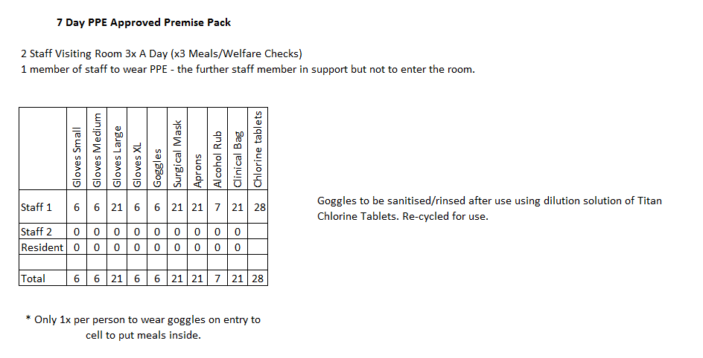
Annex C – 7 Day AP PPE pack

Slide 15
Annex D – Guidance for cleaning goggles
The goggles supplied with this PPE grab pack must cleaned and washed thoroughly with a Titan chlorine solution after every use. The following procedure must be followed once the goggles have been removed.
Sterilising of eye goggle procedure.
Remove the goggles by the wearer as per SSOW.
Items required to for thouroughly cleaning are 1 x bucket (clean) 2 x Titan Chlorine tablets per 1 litre of warm water (make solution at this ratio and as required). The disinfectant solution should be prepared within the clean bucket by adding warm water with the Titan Chlorine tablets (1000 ppm available Chlorine). Please note – Stocks may be supplied with Titan Chlor Plus Tablets (the dilution rates differ as 1 tablet per I litre). The pack will specify whether the tablets are the Plus type.
1. Place goggles in bucket of warm water containing the solution
2. Soak your goggles & straps in the disinfectant solution for approximately 10 Minutes.
3. The googles must be rinsed thoroughly & allowed to dry before the next use.
DO NOT DISGARD THE GOGGLES AFTER NEED. CONTACT YOUR REGIONAL COVID-19 PPE SPOC AS THESE CAN BE RECYLCLED FOR USE – PLEASE ENSURE ANY RECYCLED GOGGLES ARE FULLY CLEANED.

